Slide 1

Computer Communications
& Networks
SENS-3523
Week: 1
Computer Networking: A Top Down Approach
6th edition
Jim Kurose, Keith Ross
Addison-Wesley
March 2012
Introduction, N/W Edge, Core N/W
Packet capture & analysis
Dr Nauman Mazhar
Faculty of Information Technology (FIT)
University of Central Punjab (UCP)

Slide 2

Instructor
DR NAUMAN MAZHAR
Associate Professor, Faculty of IT&CS
PhD (Computer Engineering)
  Computer Networks & Security
  CASE, Islamabad, research element in Michigan State University, USA
MS (Computer Engineering)
  Computer Networks & Security
  IOWA State University, USA
BE (Avionics Engineering)
  College of Aeronautical Engg (CAE), PAF Academy Risalpur (NED Univ)
nau.maz@ucp.edu.pk

Slide 3
Course Intro
Basic course in Computer Networking
Provides overview of…
  What are computer networks
  How do they operate
  How they are designed
Computer Networks …??
Infrastructure, comprising H/W & S/W,
to allow remote, distributed apps
to communicate with each other
& provide variety of services
Extension of
Inter Process Communication (IPC)…!!!

Slide 4
Course Contents
application
transport
network
link
physical
Computer Networks & the Internet
  Nuts & Bolts description
  Services description
  Network Edge & Core
  Delay, Loss & Throughput in packet switched networks
  Network architectures (TCP/IP, OSI)
Application Layer
  Principles/architectures of N/W applications
  Services required by Apps, & made available by N/W
  Application layer protocols
  (Web/HTTP, DNS, FTP, SMTP, POP3)
  Apps development; Socket Programming (TCP & UDP)

Slide 5
Course Contents
application
transport
network
link
physical
Transport Layer
  Concept of process-to-process comm
  Connection less, unreliable transport – UDP
  Reliable data transfer (Go-Back-N, Selective Repeat ARQ)
  Connection oriented, reliable transport – TCP
  TCP Connection management, Flow control, Congestion Control
Network Layer
  Concept of host-to-host comm
  Forwarding & routing, what’s inside a router
  IPv4 protocol, Addressing, Subnetting, CIDR
  DHCP, NAT, ICMP, IPv6 protocol
  Routing algorithms – LS/DV routing

Slide 6
Course Contents
application
transport
network
link
physical
Link Layer
  Concept of hop-to-hop comm
  Link layer functions
  Multiple access protocols
  Link layer addressing, ARP
  Link layer Technologies…
    Ethernet – IEEE 802.3 standard
    WiFi – IEEE 802.11 standard

Slide 7
Course Contents
Network Programming :
  Socket Programming
    Client/Server communications paradigm
    TCP & UDP client-server comm
    Iterative & Concurrent servers
    (threads & child processes)
    I/O multiplexing, select()
    Unix network programming in ‘C’
      (Socket API)

Slide 8

Books Recommended
Text:
Computer Networking: A Top-Down Approach (8th Ed)
  by James F. Kurose & Keith W. Ross
Unix Network Programming – Vol I
  by W Richards Stevens
Ref:
Computer Networks: A Systems Approach (6th Ed)
  by Larry L. Peterson & Bruce S. Davie

Slide 9
Course Methodology
Lectures
16 power point lectures
Study relevant sections of Text/Ref books
Assignments
Assignment done individually or in groups
To be submitted exactly when due
5% marks deduction per day for being late
After one week – Not Accepted
Exam Pattern
Exams to include complete material in covered chapters
MCQs, short answers, problems, design questions

Slide 10
Grading Policy
Quizzes ………. 04 15%
Assignments ……… . 04 15%
Class participation ..….…. 05%
Mid-exam ..….…. 25%
Final-exam .……… 40%
Distribution is tentative and flexible

Slide 11
Academic Honesty
Your work in this class must be your own
If students are found to have:
  collaborated excessively, or
  copied/shared answers
For the first infraction…
  all involved, at a min, will receive grades of 0
Further infractions…
  will result in failure in course

Slide 12
Attendance Policy
Strictly in accordance with the Univ policy…
Office Hours
Office : Room 101, C-Block
Office Hours : ???

Slide 13
Lets Start the Course…

Slide 14
Chapter 1: roadmap
  1.1 what is the Internet?
  1.2 network edge
    end systems (hosts), access networks, links
  1.3 network core
    packet switching, circuit switching, network structure
  1.4 performance
    delay, loss, thruput in networks
  1.5 protocol layers, service models
  1.6 networks under attack: security
  1.7 history

Slide 15
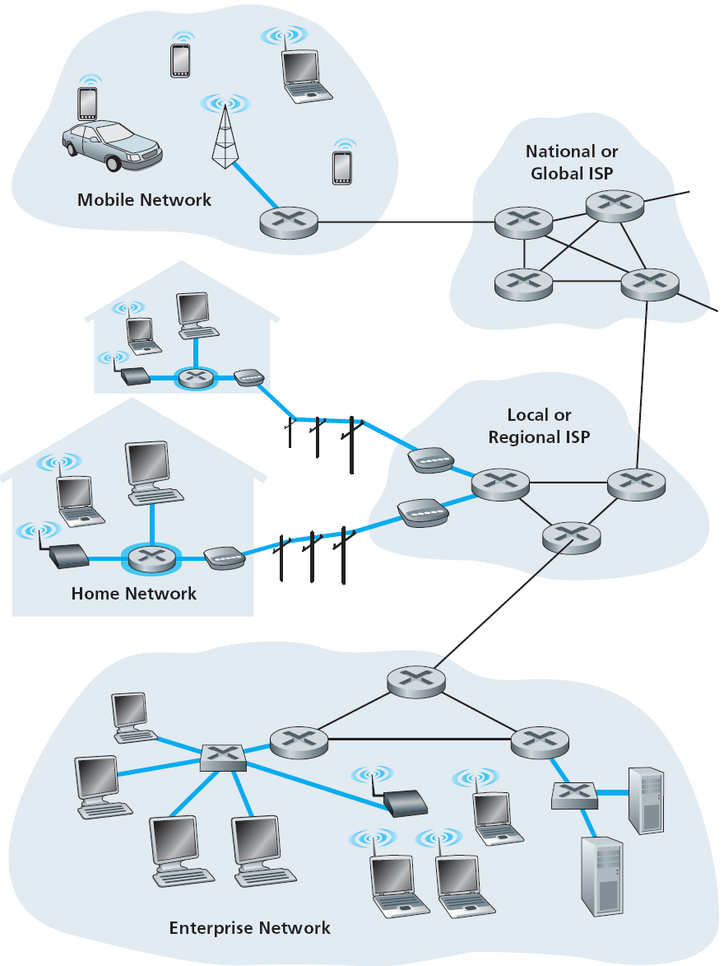
What’s the Internet
Internet
“Network of networks”
  hierarchical structure of interconnected ISPs
  lower tier ISPs, upper tier ISPs, …
  user N/Ws plug into ISP N/Ws
Nuts & Bolts view…!
Services view…!

Slide 16






What is the Internet: “Nuts & Bolts” view
What basic components make
up the Internet…
PC
End systems:
  hosts & servers
  run network apps
  generate/use data
server
wireless
laptop
smartphone
Communication links:
  media: copper, fiber,
  radio, satellite
  range, data rate
wireless
links
wired
links
Switching nodes:
  forward/route pkts
  switches, routers
router

Slide 17
What’s the Internet: “Nuts & Bolts” view
Network “protocols”
  run at end systems, switches, routers
  control sending/receiving
  of msgs
  HTTP, DNS, TCP, UDP, IP, ARP
Protocols → Internet standards
  IETF : Internet Engineering Task
  Force
  RFC : Request for comments

Slide 18


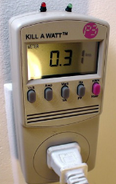



“Fun” Internet appliances
Web-enabled toaster +
weather forecaster
IP picture frame
http://www.ceiva.com/
Tweet-a-watt:
monitor energy use
Slingbox: watch,
control cable TV remotely
Internet
refrigerator
Internet phones

Slide 19
What’s the Internet: Services view
Internet provides services to Apps…
  Apps: Web, Email, VoIP, E-commerce, audio/video on demand, Internet TV/radio, social nets, online games, video conf
  Distributed Apps: involve multiple end systems that exchange data remotely
  Apps require different services:
    reliable or unreliable data delivery
    min thruput
    max delay
    security
  How do apps ask for services
  from the N/W …??

Slide 20
What’s the Internet: Services view
End Systems provide Apps with an interface to Internet
  Network API
  library functions that allow process on source system to:
    “connect” to destination system via Internet
    “send/recv” data
  also specifies…
    how to select options
    for various “types of services”

Slide 21



What’s a protocol?
An important buzzword in computer networking… “Protocol“
“pre-defined set of rules”
Analogy… Human protocol & Computer Network protocol
Hi
TCP connection
request
Hi
TCP connection
response
Got the
time?
Get http://www.awl.com/kurose-ross
2 pm
<file>
time

Slide 22
Why Network protocols?
machines in distributed environment need coordination to interact with each other
require some rules to operate → protocol
Network protocols define…
format/order of msgs among network entities,
& actions taken on msg Tx/Rx
Syntax
Semantics
Timings/order
all communications in Internet is governed by protocols…
  specific msgs sent
  specific actions taken when msg sent & recvd,
  or some event occurs

Slide 23
Network Structure
Network edge
  end systems
    hosts, servers, apps
  access networks
    connect end systems
    to edge routers
    wired/wireless comm
    links
Network core
  interconnection of routers
  route pkts from Src N/W to
  Dst N/W

Slide 24














The network edge
End systems (hosts)
  run appl programs
  web, email, DB
Client/server model
  hosts act as clients or servers
  server – always ON powerful machine
  client – request/receive service
  web browser/web server
  email client/mail server
Peer-peer model
  all hosts equal
  minimal (or no) use of dedicated servers
  Bitcoin, BitTorrent, Gnutella, WhatsApp

Slide 25
Access networks
Networks to connect end systems to edge router
Several types of access networks exist for various settings…
  home access
  enterprise access
  wireless access
points to note…
range & data rate of access network…?
access is shared or dedicated…?

Slide 26
Home Access
How do homes connect to Internet
Fiber to the Home (FTTH)
Digital Subscriber Line (DSL)
Cable Internet access
Dial up modem
Two most prevalent ones are
FTTH & DSL

Slide 27
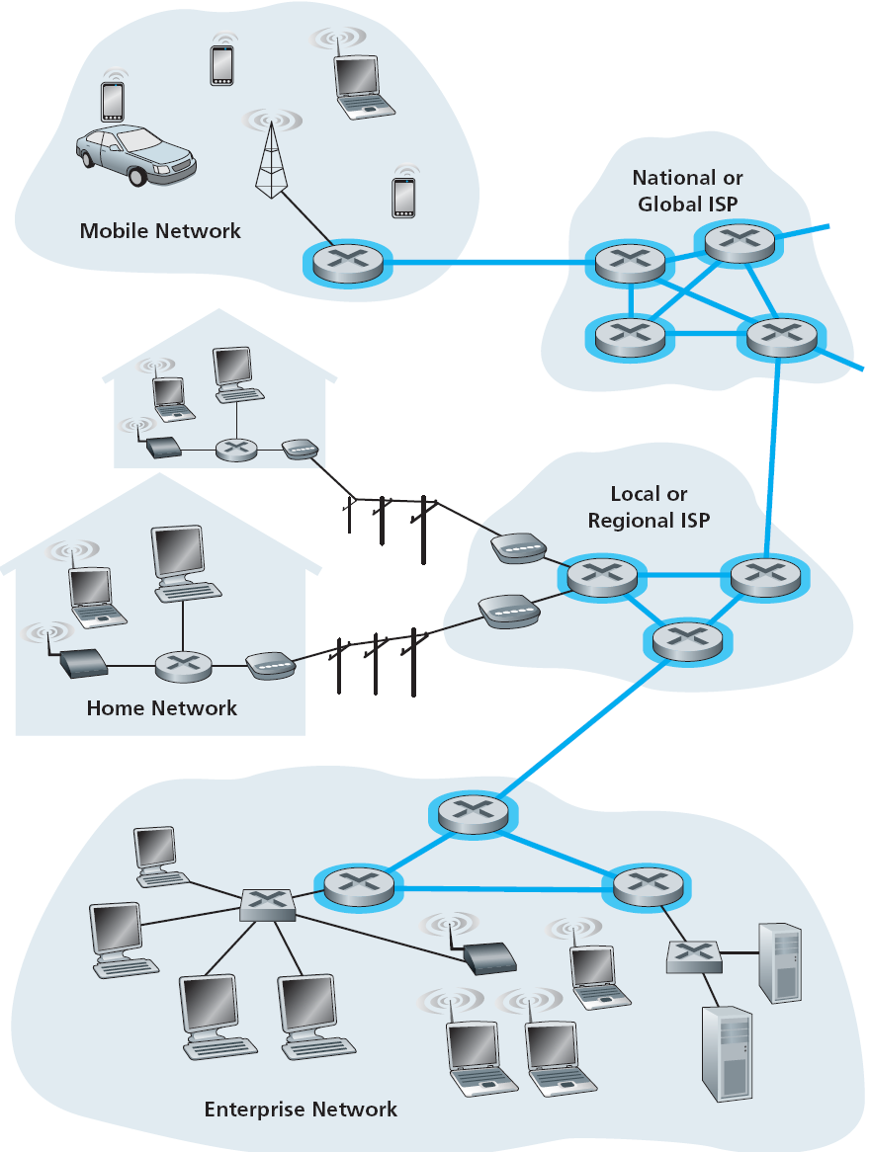
The network core
Mesh of interconnected routers
Fundamental question…
“how is data transferred thru N/W”
  Circuit switching
    resources along the path reserved for Tx duration
    e.g, telephone network
    guaranteed service
  Packet switching
    N/W resources used on demand
    e.g, Internet
    best effort service

Slide 28
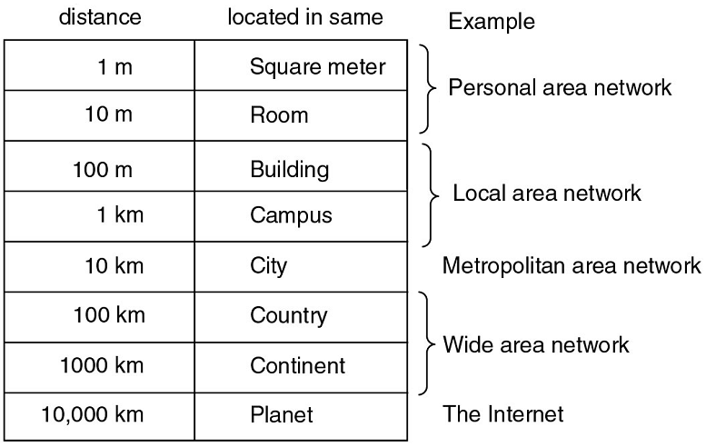
Network Categorization
Networks categorized
based on coverage:
  Personal Area Network
  (PAN)
  Local Area Network
  (LAN)
  Metropolitan Area
  Network
  (MAN)
  Wide Area Network
  (WAN)
also, sensor network, vehicular network, IoT

Slide 29
Network Architecture
Notes:
The long-distance carrier system provided in the United States and throughout the world was designed to transmit voice signals over high-capacity transmission links, such as optical fiber, coaxial cable, and microwave. Part of the evolution of these telecommunications networks to digital technology has been the adoption of synchronous TDM transmission structures. In the United States, AT&T developed a hierarchy of TDM structures of various capacities; this structure is used in Canada and Japan as well as the United States. A similar, but unfortunately not identical, hierarchy has been adopted internationally under the auspices of ITU-T.
The basis of the TDM hierarchy (in North America and Japan) is the DS-1 transmission format. The same DS-1 format is used to provide both multiplexed voice and digital data services. Above the DS-1 data rate of 1.544 Mbps, higher-level multiplexing is achieved by interleaving bits from DS-1 inputs. For example, the DS-2 transmission system combines four DS-1 inputs into a 6.312-Mbps stream. Data from the four sources are interleaved 12 bits at a time. Note that 1.544 × 4 = 6.176 Mbps. The remaining capacity is used for framing and control bits.

Slide 30
Network Architecture
Network communications – complex task
To simplify and standardize comm task, Modular approach was adopted
  overall comm function divided into small
  tasks – modules
  modules arranged in layers
  each module implemented as a protocol
Forms layered Network Architecture
  each layer has one/more protocols
  each protocol performs a specific comm task
  layer obtains services from lower one
  layer provides services to higher one
modules/protocols
modules/ protocols
modules/ protocols
modules/ protocols
Notes:
The long-distance carrier system provided in the United States and throughout the world was designed to transmit voice signals over high-capacity transmission links, such as optical fiber, coaxial cable, and microwave. Part of the evolution of these telecommunications networks to digital technology has been the adoption of synchronous TDM transmission structures. In the United States, AT&T developed a hierarchy of TDM structures of various capacities; this structure is used in Canada and Japan as well as the United States. A similar, but unfortunately not identical, hierarchy has been adopted internationally under the auspices of ITU-T.
The basis of the TDM hierarchy (in North America and Japan) is the DS-1 transmission format. The same DS-1 format is used to provide both multiplexed voice and digital data services. Above the DS-1 data rate of 1.544 Mbps, higher-level multiplexing is achieved by interleaving bits from DS-1 inputs. For example, the DS-2 transmission system combines four DS-1 inputs into a 6.312-Mbps stream. Data from the four sources are interleaved 12 bits at a time. Note that 1.544 × 4 = 6.176 Mbps. The remaining capacity is used for framing and control bits.

Slide 31
Network Architecture
Network Comm Architecture
A structured set of protocols to implement the
communications function
Internet Architecture
(TCP/IP Architecture)
5-layer model
application
transport
network
link
physical
OSI Model
older 7-layer model
no longer in use

Slide 32
Internet Architecture
Application: support applications – network API
  HTTP, DNS, DHCP, FTP, SMTP
Transport: process-process data transfer (ports)
  TCP (reliable), UDP (unreliable)
Network: host-host data transfer, global
addressing (IP addr), routing of pkts from src to
dest
  IPv4, IPv6
Link: hop-hop data transfer, comm between
direct neighbor devices (MAC addr)
  Ethernet, WiFi (802.11), 3G/4G, PPP
Physical: signal encodings, media, connectors
application
transport
network
link
physical

Slide 33
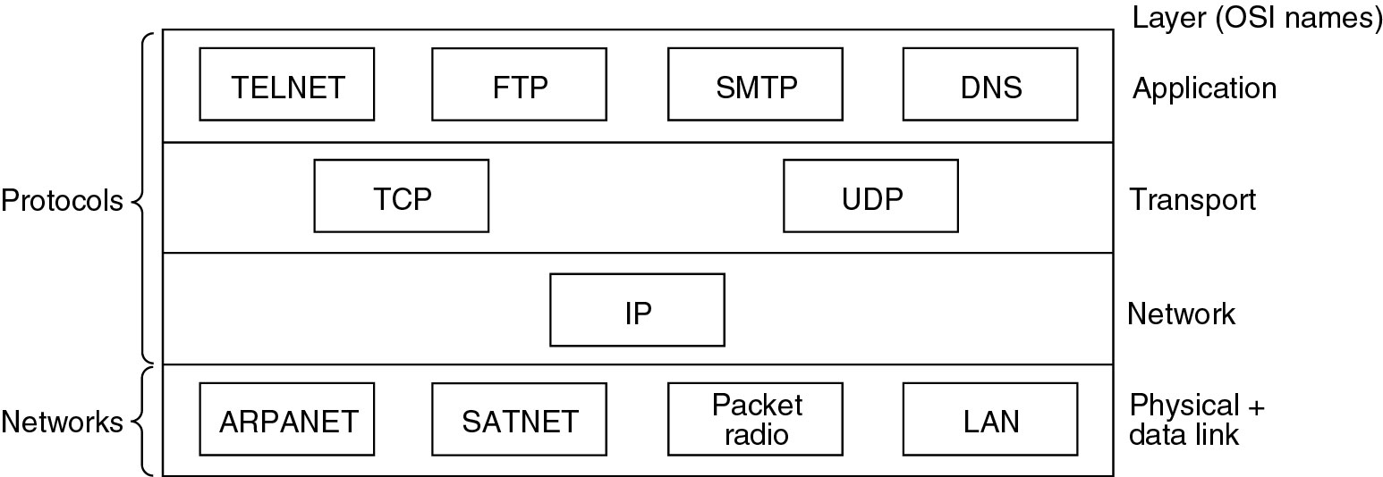
TCP/IP Protocol Suite
Some of the protocols & networks in TCP/IP protocol stack…
HTTP
FTP
SMTP
DNS
(IETF)
Ethernet
WiFi
3G/4G
PPP
(IEEE)

Slide 34
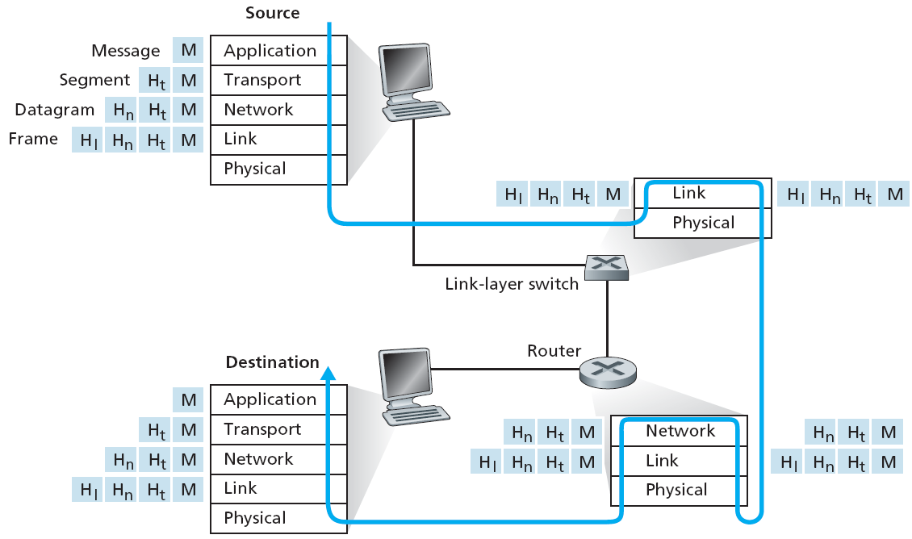
Encapsulation
Encapsulation & Decapsulation
Data generated by Appl layer
When being sent, each layer appends its header
When being received, each layer removes its header

Slide 35
Why Layered Architecture
Network Architecture – Layered architecture
  provides modularity
    change in one module does not require changes in other modules in other layers
    (as long as module interfaces remain same)
  simplifies troubleshooting
  allows to modify/improve individual modules, when:
    new technology emerges
    application demands increase
Notes:
The long-distance carrier system provided in the United States and throughout the world was designed to transmit voice signals over high-capacity transmission links, such as optical fiber, coaxial cable, and microwave. Part of the evolution of these telecommunications networks to digital technology has been the adoption of synchronous TDM transmission structures. In the United States, AT&T developed a hierarchy of TDM structures of various capacities; this structure is used in Canada and Japan as well as the United States. A similar, but unfortunately not identical, hierarchy has been adopted internationally under the auspices of ITU-T.
The basis of the TDM hierarchy (in North America and Japan) is the DS-1 transmission format. The same DS-1 format is used to provide both multiplexed voice and digital data services. Above the DS-1 data rate of 1.544 Mbps, higher-level multiplexing is achieved by interleaving bits from DS-1 inputs. For example, the DS-2 transmission system combines four DS-1 inputs into a 6.312-Mbps stream. Data from the four sources are interleaved 12 bits at a time. Note that 1.544 × 4 = 6.176 Mbps. The remaining capacity is used for framing and control bits.

Slide 36
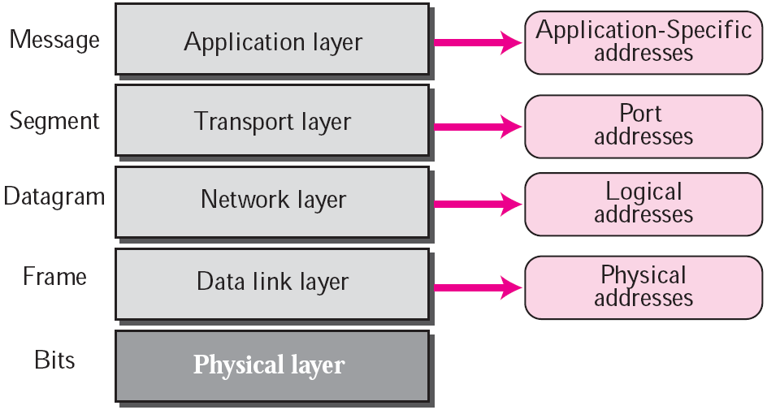
Addresses in TCP/IP
Three levels of addressing used in Internet
  each address related to one layer in TCP/IP
Port Nums
IP Addrs
MAC Addrs

Slide 37
Network Packet Capturing & Analysis
Notes:
The long-distance carrier system provided in the United States and throughout the world was designed to transmit voice signals over high-capacity transmission links, such as optical fiber, coaxial cable, and microwave. Part of the evolution of these telecommunications networks to digital technology has been the adoption of synchronous TDM transmission structures. In the United States, AT&T developed a hierarchy of TDM structures of various capacities; this structure is used in Canada and Japan as well as the United States. A similar, but unfortunately not identical, hierarchy has been adopted internationally under the auspices of ITU-T.
The basis of the TDM hierarchy (in North America and Japan) is the DS-1 transmission format. The same DS-1 format is used to provide both multiplexed voice and digital data services. Above the DS-1 data rate of 1.544 Mbps, higher-level multiplexing is achieved by interleaving bits from DS-1 inputs. For example, the DS-2 transmission system combines four DS-1 inputs into a 6.312-Mbps stream. Data from the four sources are interleaved 12 bits at a time. Note that 1.544 × 4 = 6.176 Mbps. The remaining capacity is used for framing and control bits.

Slide 38
Packet Capturing & Analysis
Packet Capturing done using Packet sniffers
  “programs with ability to capture all network traffic,
  whether or not destined to it”
Done by N/W Admins & Black Hat community
  network monitoring, traffic analysis, launching N/W attacks
How Packet Sniffer works…
  runs NIC in promiscuous mode to capture all pkts
  decodes pkt headers & data
  displays info for each packet
Common Packet Sniffers
  Wireshark, tcpdump, etc

Slide 39
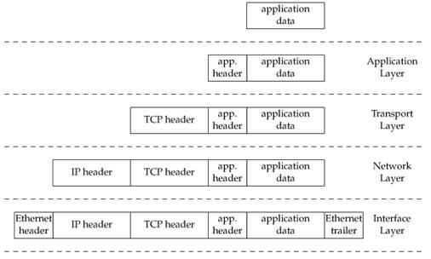
What is a Packet ?
Application
Layer
Segment
Transport
Layer
Packet
Network Layer
Frame
Link
Layer
Physical Layer

Slide 40
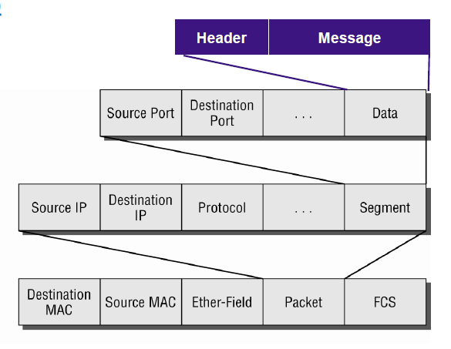
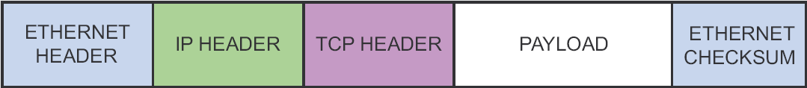
Some Header Fields !!
Transport
Layer
Network Layer
Data Link
Layer

Slide 41
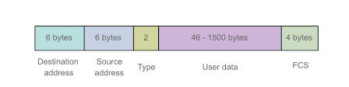
MAC Layer Processing
NIC receives Ethernet frame – from wire into card buffer
  matches address → Dest MAC addr & Own MAC addr
  if same → calls Network Card Driver
Actions by NIC driver…
  copy data from card buffer to kernel memory
  inspect “ether type” field in Ethernet header → IPv4, IPv6, ARP
  pass data to appropriate upper layer protocol handler
Ethernet Header
Notes:
The University of Adelaide, School of Computer Science
Chapter 2 — Instructions: Language of the Computer

Slide 42
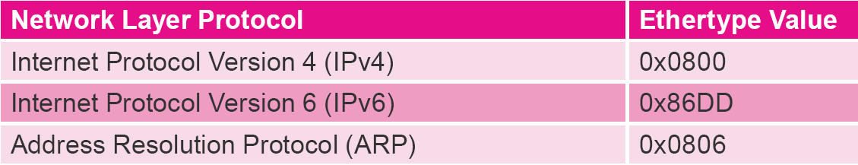
Values: Ether Type Field
Ethernet Frame Format

Slide 43
Network Layer Processing
In most cases, frame contains IPv4 datagram
  Ether Type == 0x0800
IPv4 packet handler is called, which checks:
  Dest IP addr → is pkt destined for this host
  Protocol field → what is the upper layer protocol
IP pkt destined for this host…
  payload passed to upper layer based on protocol value – TCP / UDP
Notes:
The University of Adelaide, School of Computer Science
Chapter 2 — Instructions: Language of the Computer

Slide 44
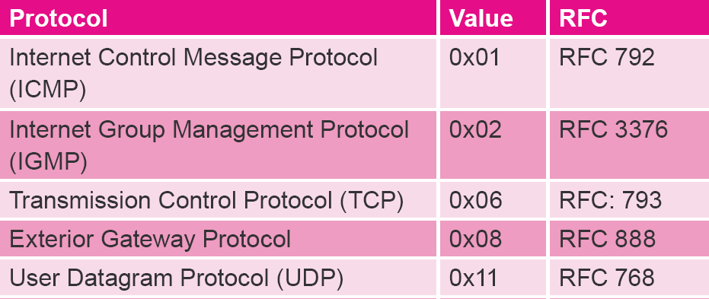
Values: Protocol Field

Slide 45
Transport Layer Processing
TCP or UDP handler performs its own protocol processing…
  data then delivered to application layer
How does TCP/UDP determine destination application…?
  based on Port number…!!
      (web 80, email 25, DNS 53, ftp 20/21, etc)
  data is passed to user level appl according to Port number
Notes:
The University of Adelaide, School of Computer Science
Chapter 2 — Instructions: Language of the Computer

Slide 46
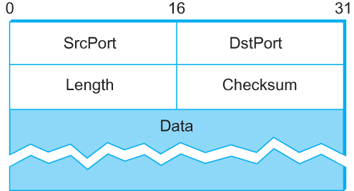

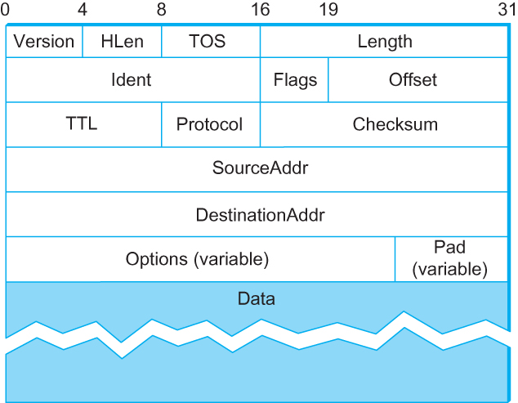
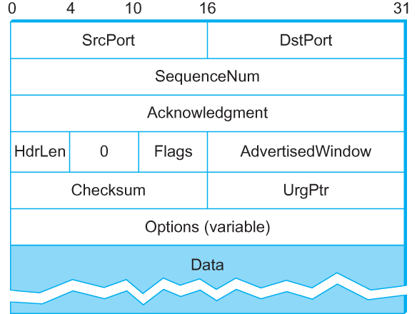
Header Formats
Notes:
Stallings DCC8e Figure 16.3 depicts the frame format for the 802.3 protocol. It consists of the following fields:
• Preamble: A 7-octet pattern of alternating 0s and 1s used by the receiver to establish bit synchronization.
• Start Frame Delimiter (SFD): The sequence 10101011, which indicates the actual start of the frame and enables the receiver to locate the first bit of the rest of the frame.
• Destination Address (DA): Specifies the station(s) for which the frame is intended. It may be a unique physical address, a group address, or a global address.
• Source Address (SA): Specifies the station that sent the frame.
• Length/Type: Length of LLC data field in octets, or Ethernet Type field, depending on whether the frame conforms to the IEEE 802.3 standard or the earlier Ethernet specification. In either case, the maximum frame size, excluding the Preamble and SFD, is 1518 octets.
• LLC Data: Data unit supplied by LLC.
• Pad: Octets added to ensure that the frame is long enough for proper CD operation.
• Frame Check Sequence (FCS): A 32-bit cyclic redundancy check, based on all fields except preamble, SFD, and FCS.

Slide 47
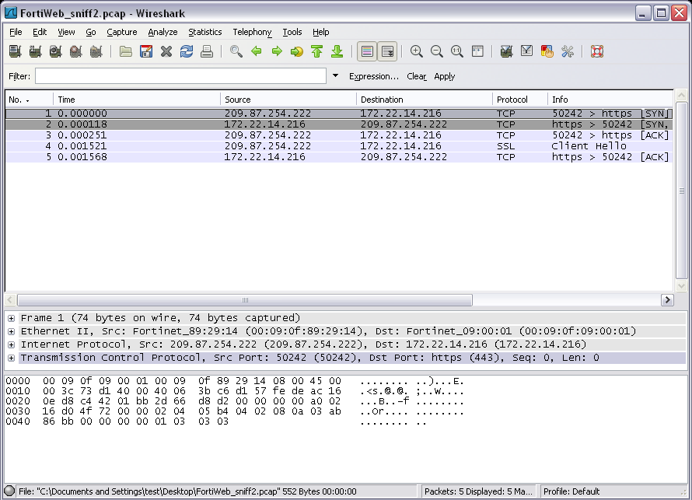

Slide 48
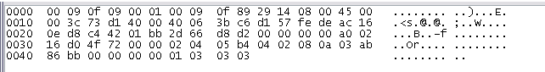
Hex Dump Analysis

Slide 49
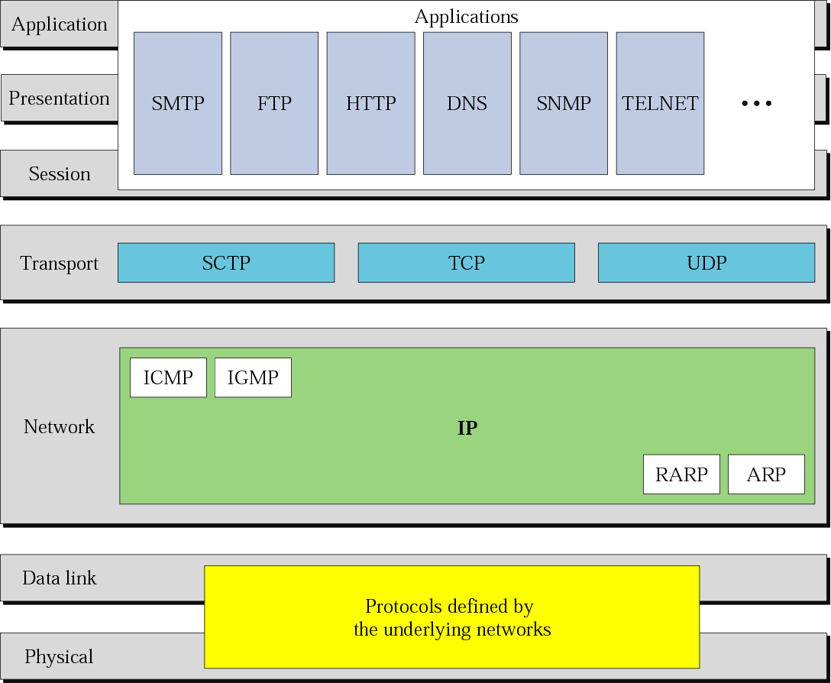
TCP / IP Protocols
UDP
TCP
Ethernet
PPP
WiFi
DSL

